Slide 1
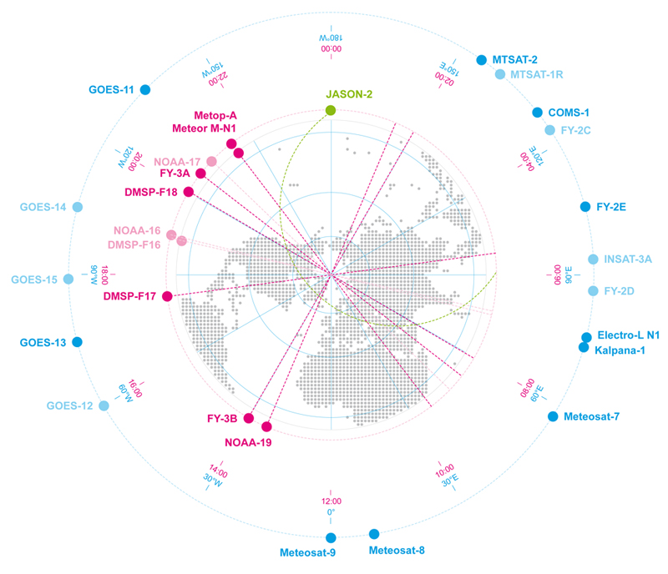
CGMS Risk Assessment

Slide 2
CGMS Baseline - Background
The CGMS Baseline enumerates the sustained observations, measurements, and services that form the CGMS contribution to observing the Earth System, Space Environment and the Sun.
The CGMS baseline responds to end-user requirements expressed in WMO’s Rolling Review of Requirements (RRR).
The CGMS Baseline strives to support the WMO Integrated Global Observing System (WIGOS) 2040 vison.
Key principles:
Commitment: The CGMS Members are providing, or have firm plans to provide, the observations, measurements, and services enumerated in the Baseline
Sustained: The observations, measurements, and services are provided on a sustained basis
Available: The observations, measurements, and services are available on a free and open basis
Operational: The data and products can be utilized in operational applications

Slide 3
CGMS Baseline - Background
The CGMS Baseline constitutes the CGMS response to the WIGOS 2040 Vision to document what missions are currently being, or planned on being flown. The CGMS baseline will be included in the WMO Manual on WIGOS.
WMO will conduct a Gap Analysis between the WIGOS 2040 Vision Tier 1 and the CGMS Baseline to review implementation of WIGOS.
CGMS conducts a Risk Assessment against the baseline to track how CGMS is meeting its commitments.
The WMO Gap Analysis will occur every four years, serving as an input to the definition of the revised CGMS Baseline.
The CGMS Risk Assessment will be completed every year forming the basis for CGMS actions to ensure continuity.

Slide 4
CGMS Baseline Update / Risk Assessment Process
Member
Input
OSCAR Database
Satellite Flyout to 10 years
Satellite Flyout
Activities Conducted Prior to Workshop
Member updates include those at Workshop and from previous CGMS reports
Update with Member Reports
Risk assessment includes evaluation of data quality and distribution
Risk Assessment
CGMS Baseline
Activities Conducted At Workshop
Activities Conducted At CGMS
WG-III Review
Actions / HLPP
Report to CGMS Plenary

Slide 5
CGMS Risk Assessment Workshop
Objective:
Update CGMS Baseline based on member inputs
Prepare a consolidated Risk Assessment against the CGMS Baseline
Identify contingency actions to be taken, or actions to identify in the High Level Priority Plan
Identify ways to integrate critical satellite data into the CGMS Baseline
Working Group III held a workshop 19-21 February 2020, hosted by EUMETSAT and attended by Representatives of WGII and Space Weather Task Force
The findings and actions from this Workshop were sent to other Working Groups for review and discussed at Working Group III Intersessional #3

Slide 6
CGMS Risk Assessment Assumptions
The final risk assessment for each sensor/observation was based on a qualitative analysis of all the orbits from which the observation is provided.
This assessment is given from a CGMS Member prospective and does not currently include non-CGMS member, nor commercial contributions to the global observing system, or incorporate all WMO requirements (which are covered by the gap analysis).
CGMS Members are going to operate satellites based on their national priorities.
Resiliency nor the consequence of not meeting commitments was not specifically addressed.
Lack of a satellite in geostationary orbit is more likely to cause a gap in observations, while a lack of a satellite in low-Earth orbit may only degrade system performance.
Quality and availability were not analyzed in detail.
The assessment is based on planned launch dates, design life, and updated by operational experience.

Slide 7
CGMS Risk Assessment Assumptions
The information and assessment are based on the OSCAR Database as updated by WMO, member organizations and WGIII participants.
The assessment is a qualitative assessment done by Risk Assessment Workshop participants.
There is uncertainty in planned launch dates, satellite lifetimes (e.g., satellites often operate beyond their design life), operational readiness, and on-orbit health – all of which impact the risk assessment and ultimately the users.

Slide 8
CGMS Risk Assessment Assumptions
CGMS Risk Assessment uses Green, Yellow, and Red to graphically represent the overall status of that observation. The criteria for each color is as follows:
Green: CGMS Baseline met with a low risk of a gap.
Yellow: The CGMS Baseline is at moderate risk of not being fully met. Some mitigation by CGMS Members may be required.
Red: There is a high risk of not meeting the CGMS Baseline without CGMS Member action
No Color: Observation is not planned to be available until a later date
CGMS Baseline met with a low risk of a gap
CGMS Baseline at moderate risk of gap or performance degradation
CGMS Baseline at high risk of a gap in service

Slide 9
Top-Level Risk Assessment (2020)
Sensor | 2020 | 2021 | 2022 | 2023 | 2024 | 2025 | 2026 | 2027 | 2028 | 2029 | 2030 | 2031
Microwave Sounder
Hyperspectral Infrared Sounder
Radio Occultation
Multi-purpose Meteorological Imager
Multi-viewing, Multi-channel, Multi-polarisation imager
Lightning Mapper
Visible/IR Radiometer
Visible/UV Radiometer
UV Limb Spectrometer
SWIR Imaging Spectrometer
Precipitation Radar
Microwave Imager
Narrow Band Visible & Near Infrared Imager
Radar Altimetry
Scatterometer
Sub-Millimeter Ice Cloud Imager
Synthetic Aperture Radar
High Resolution Optical Imager
Coronograph
EUV Imager
X-ray Spectrograph
Magnetometer
Plasma Analyzer
Radiation Monitor
9

Slide 10
Top-Level Risk Assessment (2020) – Focus Areas
Sensor | 2020 | 2021 | 2022 | 2023 | 2024 | 2025 | 2026 | 2027 | 2028 | 2029 | 2030 | 2031
Microwave Sounder
Hyperspectral Infrared Sounder
Radio Occultation
Multi-purpose Meteorological Imager
Multi-viewing, Multi-channel, Multi-polarisation imager
Lightning Mapper
Visible/IR Radiometer
Visible/UV Radiometer
UV Limb Spectrometer
SWIR Imaging Spectrometer
Precipitation Radar
Microwave Imager
Narrow Band Visible & Near Infrared Imager
Radar Altimetry
Scatterometer
Sub-Millimeter Ice Cloud Imager
Synthetic Aperture Radar
High Resolution Optical Imager
Coronograph
EUV Imager
X-ray Spectrograph
Magnetometer
Plasma Analyzer
Radiation Monitor
10

Slide 11
Top-Level Risk Assessment (2020) – Focus Areas
Long term continuity risk for critical sensors (e.g., Microwave and Hyperspectral Sounders and Multipurpose Imagers) in the early morning orbit towards the end of the decade
CMA planning underway for a follow-on to FY-3E in the early morning orbit
A WMO Tiger Team is assessing the benefit of the early morning orbit to inform CMA’s plans
Continuity risk for the number and geographic distribution of radio occultations; especially in the low- to mid- latitudes
Recommendation to CGMS members to fly RO sensor on tropical missions
Long term plans for Atmospheric Chemistry observations need to be confirmed
Long term continuity risk for Microwave Imager in the early morning orbit; ~6GHz capability for all-weather sea surface temperatures is critical
NOAA to confirm U.S. plans for early morning coverage

Slide 12
Top-Level Risk Assessment (2020) – Focus Areas
No long term plans for a Precipitation Radar sensor
CMA should confirm plans beyond FY-3RM-1
No long term plans for a Scatterometer senor
ISRO should confirm plans beyond Oceansat-3A
Risk of a gap in Coronagraph and Plasma Analyser sensors in the near term
ISRO should confirm launch plans and capabilities of Aditya-L1 mission
Users should develop contingency plans for potential gaps

Slide 13
Radio Occultation (Atmospheric Temperature, Humidity, and Ionospheric Electron Density)
Minimum of 6000 occultations from low inclination orbits, 1000 occultation from drifting high inclination orbits, and 7600 occultations from sun-synchronous orbits.
FY-3C
FY-3D
FY-3E
Metop-A
Metop-B
Metop-C
Metop-SG A1
Metop-SG B1
Metop-SG A2
Meteor-MP N1
Meteor-MP N2
Cosmic-2
Jason-3
Jason-CS 1
Sentinel-6 MF*
FY-3RM-1
Jason-CS 2
Sentinel 6B*
FY-3RM-2
2020
2021
2022
2023
2024
2025
2026
2027
2028
2029
2030
2031
2020
Today
2031

Slide 14
Radio Occultation (Atmospheric Temperature, Humidity, and Ionospheric Electron Density)
Minimum of 6000 occultations from low inclination orbits, 1000 occultation from drifting high inclination orbits, and 7600 occultations from sun-synchronous orbits.
The CGMS Baseline commitment is met through the first part of the decade; however, there is a high risk of not meeting the commitment from low inclination orbits in the later part of the decade as there are no plans for a follow-on to COSMIC-2
Inconsistent coverage from polar and high inclination orbits throughout the period (commitment for number of occultations can be met, but not the geographic distribution or performance to meet NWP requirements
WGIII Assessment:
The CGMS Baseline commitment is met in for the first half of the decade but may not fully meet NWP requirements. Commercial operators could offer some risk mitigation (would need to ensure compliance with national and international mandates and policies). FY3RM may offer additional mitigation. An HLPP objective (1.2) already exists to advance the atmospheric Radio Occultation constellation, with the long-term goal of providing 20000 occultations per day on a sustained basis; consider an additional recommendation for tropical missions to carry RO sensors.

